Slide 1




Slide 2

MIXTURES AND ALLIGATIONS

Slide 3
Test time on :
QR CODE:

Slide 4
Question: 01
In what ratio must wheat A at Rs. 10.50 per kg be mixed with wheat B at Rs. 12.30 per kg, so that the mixture be worth of Rs. 11 per kg?
13 : 5
18 : 3
17 : 5
11 : 5
Answer: A

Slide 5
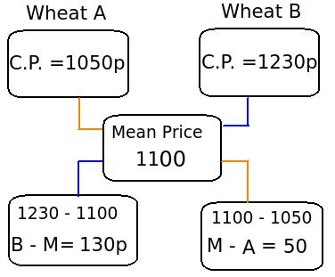

Explanation: 01
Convert Rs into paise, to make the calculation easy
The required ratio = 130 : 50 = 13 : 5
Notes:
D

Slide 6
Question: 02
In what ratio must a shopkeeper mix Peas and Soybean of Rs. 16 and Rs. 25 per kg respectively, so as to obtain a mixture of Rs. 19.50 ?
9 : 5
7 : 5
11 : 7
12 : 8
Answer : C

Slide 7
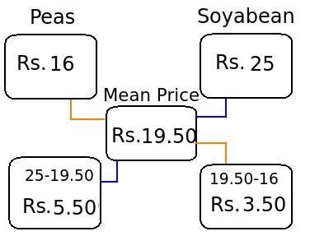
Explanation: 02
Use rule of alligation, to determine the ratio
The required ratio of Soybean and Peas = 5.50 : 3.50 = 11 : 7
Notes:
D

Slide 8
Question: 03
10 gallons are drawn from a container full of alcohol and filled with water again. 10 gallons of mixture are again drawn and the container is filled with water again. If the ratio of alcohol and water left in the container is 49 : 32, then find how much quantity does the container hold?
35
45
55
60
Answer : B

Slide 9
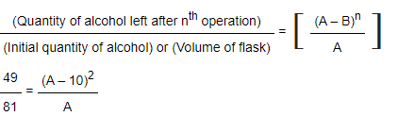
Explanation: 03
Initially the container contains only wine. 10 gallons of alcohol was removed and same quantity of water was added.
This process is again repeated by replacing the mixture( alcohol + water) of 10 gallons with same quantity of water. Hence, the initial quantity of wine and the final quantity of water and alcohol is the same.
1) First assume that the initial quantity of alcohol is 'A' .
2) We are given that, the ratio of alcohol and water is 49 : 32
3) Assume initial quantity of alcohol in the container = 49 + 32 = 81 ----- (This is because we have assumed that initial quantity of alcohol = final quantity of water and alcohol)
4) Subtract the quantity of alcohol replaced by water from the initial quantity of alcohol (A – B). As this operation is repeated n times, therefore (A – B)^{n}
Therefore,
A=45 Gallons
Notes:
D

Slide 10
Question: 04
A container is filled with a mixture of water and milk in the ratio of 3 : 5. Find the quantity of mixture to be drawn off and replaced with water, in order to get the mixture as half milk and half water.
2 : 3
1 : 1
1 : 5
1 : 4
Answer : C

Slide 11
Explanation: 04
A container contains milk and water in the ratio of 3 : 5. This means that the vessel contains 8 litres of mixture. Assume that x litres of this mixture is replaced with water.
From the mixture containing water and milk of 3 : 5, x quantity of mixture is withdrawn and is replaced by water of the same quantity in the mixture. From the mixture (3x)/(8) part of water is removed and x quantity of water is added.
1) Quantity of water in the newly formed mixture = [3-(3X/8)+X]-----> (3 is the quantity of water, x is the quantity of mixture replaced by water)
2) Similarly, quantity of milk in the newly formed mixture =[5-(5X/8)]---->(Here x is not added because only water was added in the mixture and not the syrup)
[3-(3X/8)+X] = [5-(5X/8)]
5X + 24=40 -5X
X=8/5
So the part of mixture replaced from 8 litres = 8/5 *1/8= 1/5
Notes:
D

Slide 12
Question: 05
A shopkeeper has 100 kg of salt. He sells part of the total quantity A at 7% profit and the rest B at 17 % profit. If he gains 10 % profit on the whole quantity, then find how much is sold at 7 % profit and what is the quantity of part A?
30 kg
35 kg
40 kg
45 kg
Answer : A

Slide 13
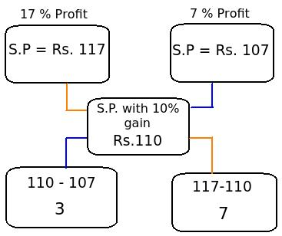
Explanation: 05
Assume that A and B are two parts of the mixture. To determine the quantity A and B, first calculate ratio of A : B.
Given:
1) Selling price of mixture with 10% profit = Rs. 110
2) With 17 % profit, the selling price of A = Rs. 117
3) With 7 % profit, the selling price of B = Rs. 107
Now, this question can be easily solved by using the rule of alligation
Now, the ratio of A : B = 3 : 7
Let the quantity of part A be 3x and part B be 7x in the total quantity of 100 kg.
Therefore, 3x + 7x = 100
10x = 100
x = 10
Quantity of part A = 3x = 3 x 10 = 30 kg
Quantity of part B = 7x = 7 x 10 = 70 kg
Notes:
D

Slide 14
Question: 06
Sugar A worth Rs. 130/kg and B of Rs. 120/kg are mixed with a third variety C in the ratio of
1 : 1 : 2. If the mixture is worth Rs. 160, then find the price of third variety of sugar.
Rs. 195
Rs. 200
Rs. 225
Rs. 230
Answer : A

Slide 15
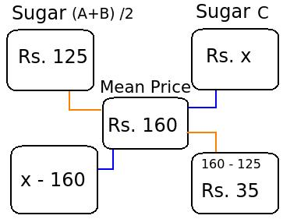
Explanation: 06
1) First calculate the average of A and B variety of sugar: (120 + 130)/2 = Rs.125
2) Now, the mixture is formed by two varieties of sugar, one at Rs. 125 /kg and assume the cost of type C Rs. x. It is formed in the ratio of 2 : 2, i.e 1 : 1
Use the rule of alligation, to easily determine the unknown quantity.
(X -160)/35 = 1
X= 35+ 160 = Rs.195
The cost of third variety of sugar C = Rs. 195
Notes:
D

Slide 16
Question: 07
Two containers P and Q contain milk and water in the ratio of 5 : 2 and 7 : 6 respectively. Find the ratio in which these two mixtures can be mixed so that a new mixture formed in the container R is in the ratio of 8 : 5.
5 : 6
4 : 9
7 : 9
9 : 7
Answer : C

Slide 17
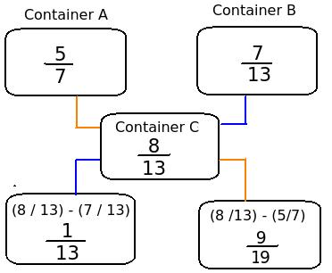
Explanation: 07
Let the cost price of milk be Re. 1 per litre.
Therefore, cost of milk in 1 litre of mixture in
Container A (Milk : Water = 5 : 2) =(5/7)*Re. 1= Re. 5/7
Container B (Milk : Water = 7 : 6) =(7/13)*Re.1=Re.7/13
Container C (Milk : Water = 8 : 5) =(8/14)*Re.1=Re. 8/14
Now use the rule of alligation, to find the required ratio
The required ratio of milk and water:
1/13 : 9/91
Simplifying, we get 7 : 9
Notes:
D

Slide 18
Question: 08
In what ratio must a shopkeeper mix two types of rice worth Rs. 50 kg and Rs. 70 kg, so that the average cost of the mixture is Rs. 65 kg?
2:1
1:2
3:1
1:3
Answer : D

Slide 19
Explanation: 08
50 70
65
5 15
5:15 = 1:3
Notes:
D

Slide 20
Question: 09
A container contains 50 litres of milk. From this container, 10 litres of milk was taken out and replaced by water. This process is repeated one more time. How much milk is now left in the container?
24
32
30
36
Answer : B

Slide 21
Explanation: 09
Amount of milk after 2 operations= [50(1-(10/50))^2]
= 50 *4/5 *4/5
= 32 litres
Notes:
D

Slide 22
Question: 10
In what ratio water must be mixed with milk costing Rs. 48 per liter to get a mixture worth Rs. 32 per liter ?
2:3
3:2
3:4
1:2
Answer : D

Slide 23
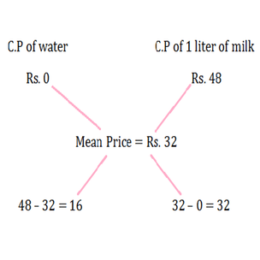
Explanation: 10
Water/Milk = 16/32=1/2
Required ratio; water:milk = 1:2
Notes:
D

Slide 24
Question: 11
8 litres are drawn from a cask full of wine and is then filled with water. This operation is performed three more times. The ratio of the quantity of wine now left in cask to that of the water is 16 : 65. How much wine the cask hold originally?
18 litres
24 litres
32 litres
42 litres
Answer : B

Slide 25
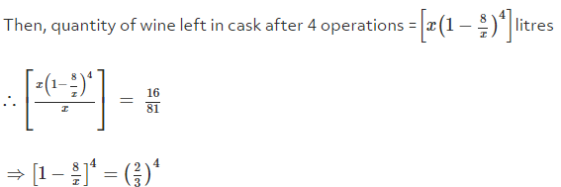
Explanation: 11
Let the quantity of the wine in the cask originally be x litres
=> x = 24
Notes:
D

Slide 26
Question: 12
A mixture of 150 liters of wine and water contains 20% water. How much more water should be added so that water becomes 25% of the new mixture?
10 litres
20 litres
30 litres
40 litres
Answer : A

Slide 27
Explanation: 12
Number of liters of water in 125 liters of the mixture = 20% of 150 = 1/5 of 150 = 30 liters
Let us Assume that another 'P' liters of water are added to the mixture to make water 25% of the new mixture. So, the total amount of water becomes (30 + P) and the total volume of the mixture becomes (150 + P)
Thus, (30 + P) = 25% of (150 + P)
Solving, we get P = 10 liters
Notes:
D

Slide 28
Question: 13
How many kilograms of sugar costing Rs. 9 per kg must be mixed with 27 kg of sugar costing Rs. 7 per Kg so that there may be a gain of 10 % by selling the mixture at Rs. 9.24 per Kg ?
36 Kg
42 Kg
54 Kg
63 Kg
Answer : D

Slide 29
Explanation: 13
C.P. of 1 kg sugar of 1st kind C.P. of 1 kg sugar of 2nd kind
Rs. 9 Rs. 7
Rs.8.40
1.40 0.60
Therefore, Ratio of quantities of 1st and 2nd kind = 14 : 6 = 7 : 3.
Let x kg of sugar of 1st kind be mixed with 27 kg of 2nd kind.
Then, 7 : 3 = x : 27 or x = (7 x 27 / 3) = 63 kg.
Notes:
D

Slide 30
Question: 14
The ratio of expenditure and savings is 3 : 2 . If the income increases by 15% and the savings increases by 6% , then by how much percent should his expenditure increases?
25
21
12
24
Answer : B

Slide 31
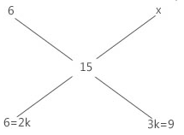
Explanation: 14
Therefore x = 21%
Notes:
D

Slide 32
Question: 15
A vessel is filled with liquid, 3 parts of which are water and 5 parts of syrup. How much of the mixture must be drawn off and replaced with water so that the mixture may be half water and half syrup?
1/3
1/4
1/5
1/7
Answer : C

Slide 33
Explanation: 15
Suppose the vessel initially contains 8 litres of liquid.
Let x litres of this liquid be replaced with water.
Quantity of water in new mixture =(3-(3X/8)+X)litres
Quantity of syrup in new mixture =(5-(5X/8))litres
(3-(3X/8)+X)= (5-(5X/8))
=> 5x + 24 = 40 - 5x
=> 10x = 16 => x = 8/5
So, part of the mixture replaced = (8/5 * 1/8)=1/5
Notes:
D

Slide 34

https://learn.codemithra.com

Slide 35




THANK YOU
+91 78150 95095
codemithra@ethnus.com
www.codemithra.com

